Slide 1
My name is Jose.
I work at ICPNA.
I am teaching B09 right now.
This month I am working on a pilot program for ICPNA.

Slide 2
What´s your name?
Where do you work?
What are you doing now?
Are you doing something different or a personal project this week or this month?

Slide 3
CONTENTS
Simple Present
vs
Present Continuous

Slide 4
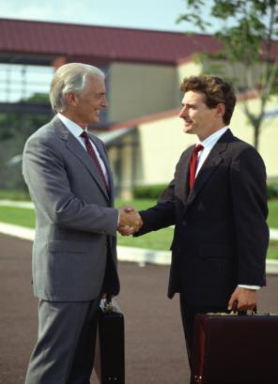
CHAPTER 1: PREVIEW
Nice to meet
you, Alex. My
name is Jonas.
My name is Alex.

Slide 5
CHAPTER 1: PREVIEW
I live in
Mexico City.
Where do
you live?

Slide 6
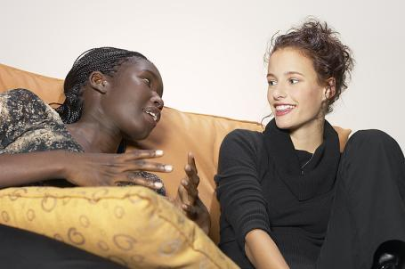
CHAPTER 1: PREVIEW
I live in an apartment
about ten minutes away by bicycle.
I live in a house
near school.
Where do you live?
Where do you live?

Slide 7
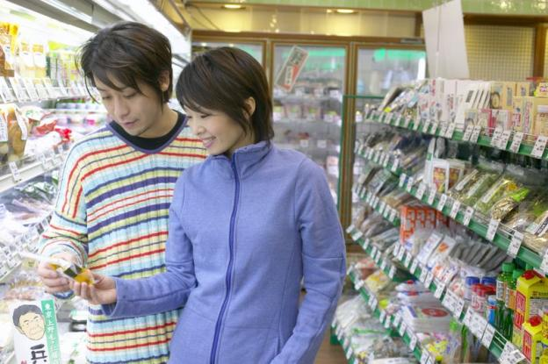
1-1 THE SIMPLE PRESENT AND THE PRESENT
PROGRESSIVE
We shop every Monday.

Slide 8
1-1 THE SIMPLE PRESENT AND THE PRESENT
PROGRESSIVE
THE SIMPLE PRESENT
past
now
future
x
x
x
x
x
x
x
x
x
x
x

Slide 9
1-1 THE SIMPLE PRESENT AND THE PRESENT
PROGRESSIVE
THE SIMPLE PRESENT
(a) Jill eats lunch every day.
(b) I usually study English
on Wednesday.
Monday
Tuesday
Wednesday
Thursday
Friday
Saturday
Sunday

Slide 10
1-1 THE SIMPLE PRESENT AND THE PRESENT
PROGRESSIVE
THE SIMPLE PRESENT
(a) Jill eats lunch every day.
(b) I usually study English
on Wednesday.
(c) Dogs bark. Lions roar.
daily habits,
usual activities
general
statements of fact
events or situations
SIMPLE PRESENT (always, usually, habitually)
in the past, present, future

Slide 11
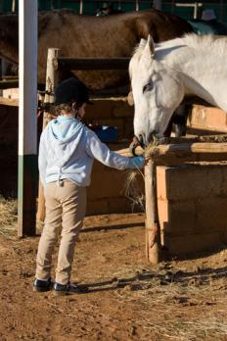
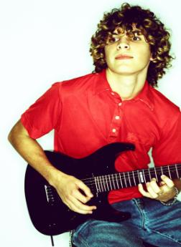
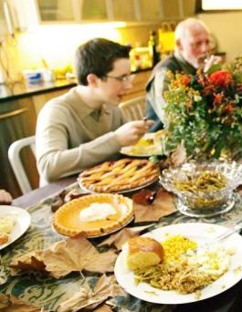
1-1 THE SIMPLE PRESENT AND THE PRESENT
PROGRESSIVE
THE PRESENT PROGRESSIVE
(f) Magda is feeding her horse right now.
(g) I can’t talk now. I am playing the guitar.
(h) They are eating dinner right now.

Slide 12
1-1 THE SIMPLE PRESENT AND THE PRESENT
PROGRESSIVE
THE PRESENT PROGRESSIVE
(f) Magda is feeding her horse right now.
(g) I can’t talk now. I am playing the guitar.
(h) They are eating dinner right now.
PRESENT an activity in progress
PROGRESSIVE (is happening right now)

Slide 13
1-1 THE SIMPLE PRESENT AND THE PRESENT
PROGRESSIVE
THE PRESENT PROGRESSIVE
start
now
finish?
x
x
x
i
n
p
r
o
g
r
e
s
s

Slide 14
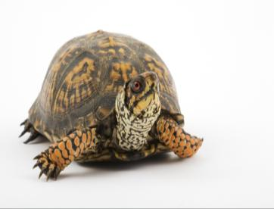
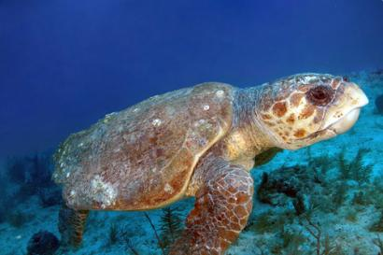
1-2 FORMS OF THE SIMPLE PRESENT AND
THE PRESENT PROGRESSIVE
It swims.
It is swimming.

Slide 15
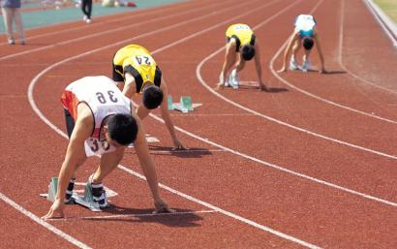
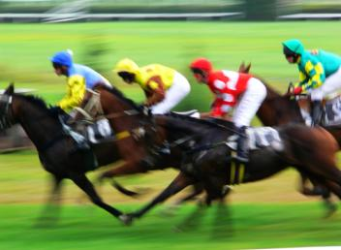
1-2 FORMS OF THE SIMPLE PRESENT AND
THE PRESENT PROGRESSIVE
STATEMENT
SIMPLE PRESENT
PRESENT PROGRESSIVE
They run.
They are running.
people in
running clothes –
but not running.

Slide 16
1-2 FORMS OF THE SIMPLE PRESENT AND
THE PRESENT PROGRESSIVE
QUESTION
SIMPLE PRESENT
PRESENT PROGRESSIVE
Do you run?
Are you running?

Slide 17
1-2 FORMS OF THE SIMPLE PRESENT AND
THE PRESENT PROGRESSIVE
CONTRACTIONS
I
+
am
=
I’m
running.
+
are
=
You’re
She’s
running.
you
she + is
=
running.
Pronoun + be

Slide 18
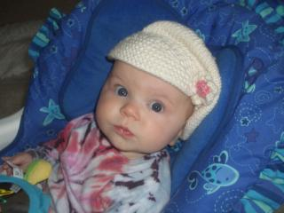
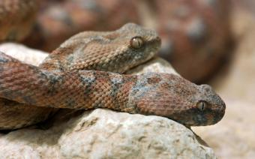
1-2 FORMS OF THE SIMPLE PRESENT AND
THE PRESENT PROGRESSIVE
CONTRACTIONS
does
+
not
=
doesn’t
do
+
not
=
don’t
She doesn’t run.
They don’t run.

Slide 19

1-2 FORMS OF THE SIMPLE PRESENT AND
THE PRESENT PROGRESSIVE
CONTRACTIONS
is
+
not
=
isn’t
are
+
not
=
aren’t
He isn’t running.
(am
+ not = am not)
They aren’t running.
I am not running.

Slide 20
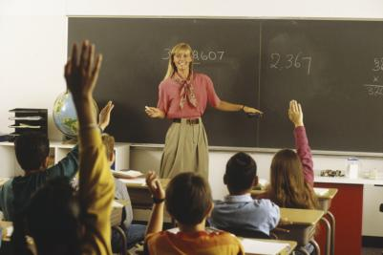
1-1 / 1-2 LET’S PRACTICE
It’s Monday, and my mom is teaching math.
?
daily / usual habit
or
happening right now

Slide 21
1-1 / 1-2 LET’S PRACTICE
She doesn’t usually teach on Monday.
?
daily / usual habit
or
happening right now

Slide 22
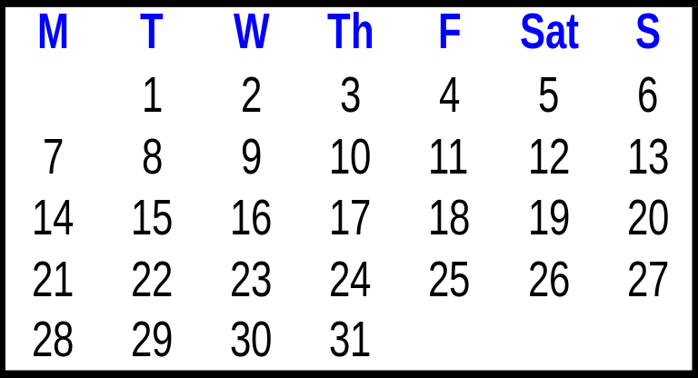
1-1 / 1-2 LET’S PRACTICE
She usually teaches on Tuesday and Thursday.
?
daily / usual habit
or
happening right now

Slide 23
1-1 / 1-2 LET’S PRACTICE
Today is unusual. She is teaching a
class for new students.
?
daily / usual habit
or
happening right now

Slide 24
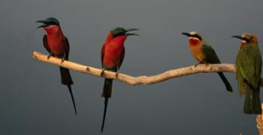
1-1 / 1-2 LET’S PRACTICE
1. Are you _______?
listening
listen
are singing
2. The birds __________ right now.
sing
sing
3. They _____ every morning.
sing

Slide 25
1-1 / 1-2 LET’S PRACTICE
watching
1. Are you ________ TV?
watch
checking email
2. No, I am ____________.
check email
3. I always ___________
before I go to sleep.
check email
check email

Slide 26
1-3 FREQUENCY ADVERBS
(a) Hannah always eats lunch at school.
SUBJECT + FREQ ADV + SIMPLE PRESENT VERB
(except be)
(b) Hannah is always happy.
+
BE
SUBJECT
+
FREQ ADV

Slide 27
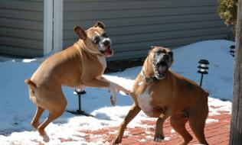
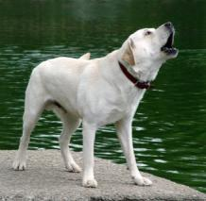
1-4 FINAL -S
(c) Dogs bark.
(d) A dog barks.
A plural noun ends in -s.
A singular verb ends in -s.

Slide 28
1-4 FINAL -S
(e) A cat plays with the ball.
It plays in the basement.
Zoe plays with her toys.
She plays happily.
Tyler plays with his toy trucks.
He plays every day.
a singular subject +
a singular verb

